Slide 1
Packet Route Tracer
Jose Gonzalez
Romeo Bellon
Vinicius Romani

Slide 2
Assignment Topic
Using your choice of programming language (this will probably require 2 languages) develop a graphical user interface (GUI) that allows the user to put in an IP address (or domain name) and then the application visually shows the route/path a data packet may take (i.e. using traceroute like application) using the internet control message protocol (ICMP).

Slide 3
The Choice
Challenging
Takeaways

Slide 4
Slow Start
Language Choices
C with libpcap
jpcap
jNetPcap
GUI Implementation
wxPython
Jython Music
Python GUI

Slide 5
(Really) Getting Started
Languages
Java
Python
GUI Implementation
JavaFX

Slide 6
What is Packet Route Tracer?
A network tool that allows users to visualize a packet’s possible route given a specific domain name.

Slide 7
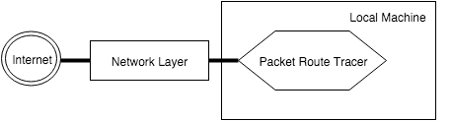
Basic Flow
Figure 1: Packet Route Tracer uses the network layer to achieve it’s goal.

Slide 8
Member Responsibilities
Romeo:
3.2.1 The GUI will be interactive, allowing for the user to input a desired domain name.
3.2.2 The GUI will display all available controls to the user.
3.2.3 The GUI will display a list of the clients traversed by the packet tracing algorithm.
3.2.4 The GUI will display the routes intuitively in a manner that can be understood easily by the user.
3.2.5 The GUI will display all of the network devices encountered and the relevant information for each device.
3.1.8 Provide a method for users to start and terminate the packet tracing algorithm.

Slide 9
Member Responsibilities Cont.
Vinicius:
3.1.1 Open and close sockets as needed throughout the algorithm.
3.1.2 Use the ICMP protocol to work with packets to determine routes.
3.1.3 Manipulate the Time to Live (TTL) field.
3.1.4 Detect the network devices along the packet path.
3.1.5 Send packets along the path.
3.1.9 Determine the geolocation of a network device along the path.
3.2.4 The GUI will display the routes intuitively in a manner that can be understood easily by the user.

Slide 10
Member Responsibilities Cont.
Jose:
3.1.7 Provide an ordered list of network devices encountered along the calculated path.
3.1.6 Repeat trace route algorithm until the destination is reached.
3.2.4 The GUI will display the routes intuitively in a manner that can be understood easily by the user.
3.1.10 (Optional): Map the network devices to a Google map using the geolocations of the devices.

Slide 11
Non-Functional Requirements
The program will use Java and Python together to create a functional and reliable application.
JavaFX will be used to efficiently create a simple and user friendly application.
Python will be used to implement the route-tracing algorithm involved.
Packet Route Tracer will be designed for OSX/Linux and will be launched by clicking on a .jar file.

Slide 12
Resources and Materials
JavaFX
Java
Python
Python Requests

Slide 13
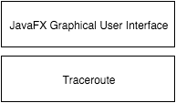
Design Overview
Figure 2: Packet Route Tracer layered architecture.

Slide 14
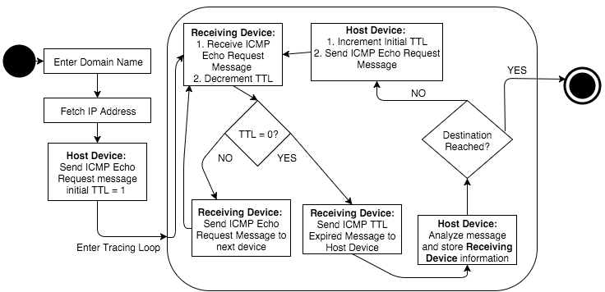
Design Overview Cont.
Figure 3: Traceroute class implementation of the trace route algorithm.

Slide 15
Detailed Design

Slide 16
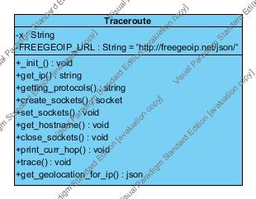
Packet Tracing Component
Figure 4: Traceroute class diagram

Slide 17
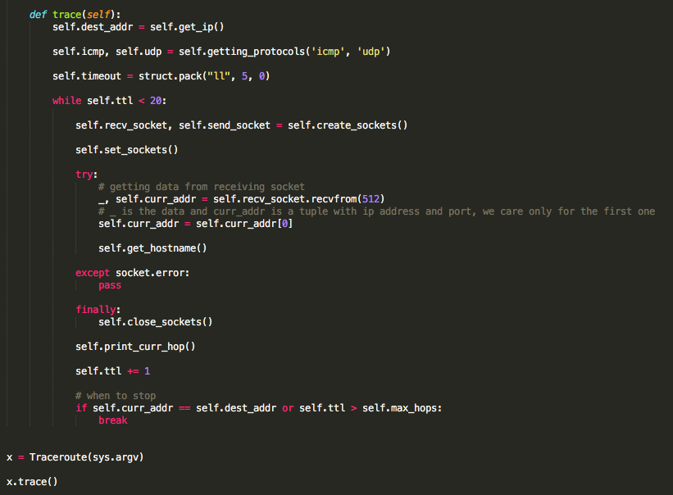
Packet Tracing Cont.

Slide 18
JavaFX FXML Application
Components:
Main
FXML style sheet
Controller class

Slide 19
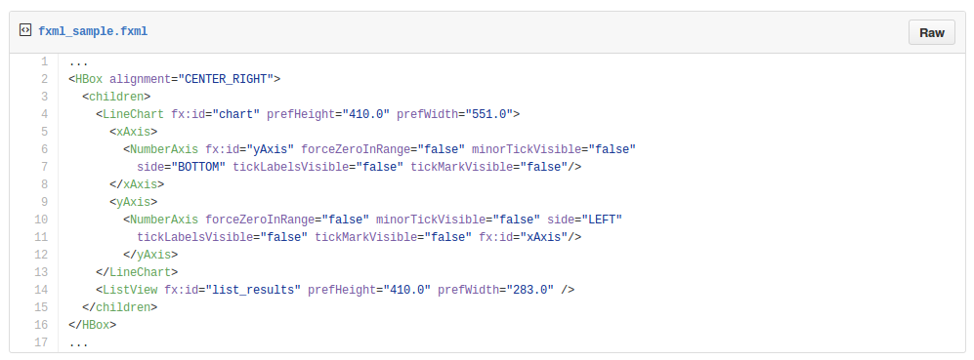
FXML Style Sheet

Slide 20
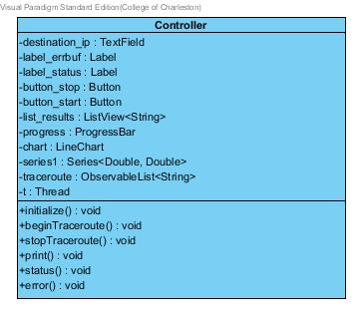
GUI/JavaFX Controller
Figure 5: Class diagram for the JavaFX Controller.

Slide 21
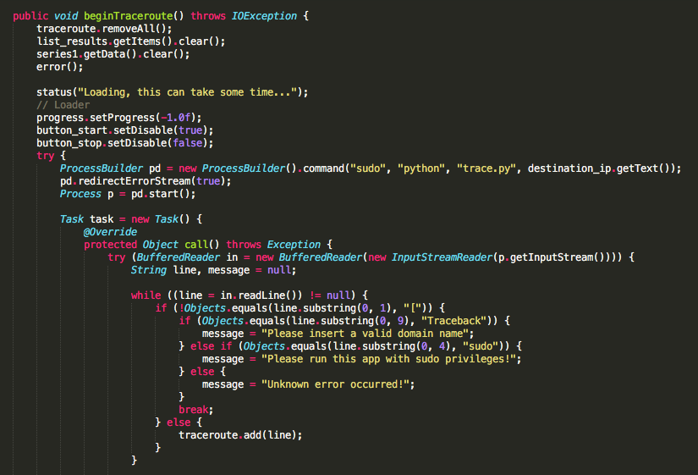
GUI/JavaFX Controller Cont.

Slide 22
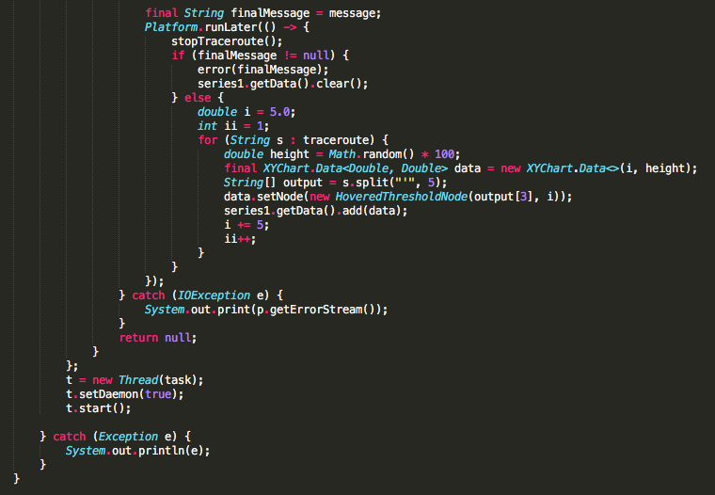
GUI/JavaFX Controller Cont.

Slide 23
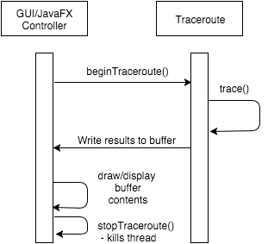
Interaction?
Figure 6: Sequence diagram for interaction
between the GUI and Traceroute.

Slide 24
Demo time!

